Slide 1
Kingsley Primary
Parents PSHE Meetings
Spring 2022
Fire alarm
Mobile phones
Questions
Translation

Slide 2
PSHE Education
Personal
Social
Health
Economic

Slide 3
How Have We Designed This In Kingsley?
Our school vision and values
- keeping children safe
-preparing children for life in secondary school and wider society
2. Our own knowledge about OUR pupils physical, mental and social development
3. Our pupils’ backgrounds , including faith and cultural aspects
4. Previous experience/ incidents / concerns which indicate certain curriculum aspects are required.

Slide 4
Overview of PSHE
(Follows PSHE Association Guidance)
Compulsory since September 2020, Kingsley have not reviewed their policy since then, due to lack of opportunity to share effectively with parents.
We have reviewed what we teach
We have updated our policy
We are not proposing many changes now in terms of content.

Slide 5
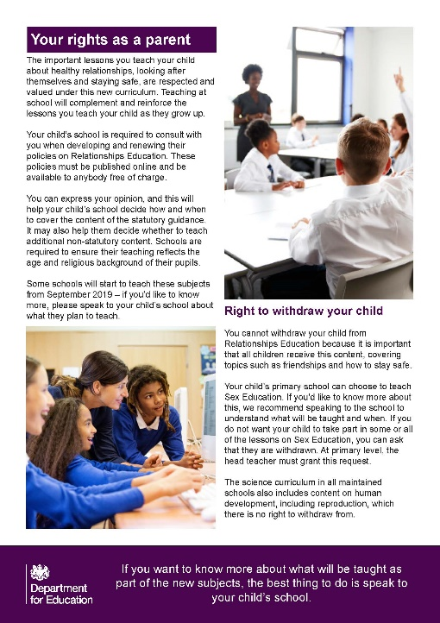
PSHE or Science?
Most elements of PSHE are statutory – no one can
withdraw
Science is statutory- no one can withdraw
Additional Sex Education is recommended by the Dfe, to be taught in PSHE- parents CAN withdraw pupils from this part
In Kingsley we have currently chosen not to teach additional sex education in PSHE, so there should be no concern about withdrawing children.

Slide 6
Sex Education
Sex Education
‘The Department continues to recommend that all primary schools should have a sex education programme tailored to the age and physical and emotional maturity of the pupils…drawing on knowledge of the human life cycle set out in National Curriculum Science - how a baby is conceived and born.
See y5 lesson

Slide 7
Science Overview In Primary School
Key stage 1.
Year 1
identify, name, draw and label the basic parts of the human body and say which part of the body is associated with each sense
Year 2
notice that animals, including humans, have offspring which grow into adults
Key stage 2
Year 5
describe the differences in the life cycles of a mammal, an amphibian, an insect and a bird
• describe the life process of
reproduction in some plants and animals
• describe the changes as humans develop to old age
• learn about the changes
experienced in puberty

Slide 8
Secondary School Science
Key stage 3
reproduction in humans (as an
example of a mammal), including
the structure and function of the
male and female reproductive
systems, menstrual cycle (without
details of hormones), gametes,
fertilisation, gestation and birth, to
include the effect of maternal
lifestyle on the foetus through the
placenta
Key stage 4
communicable diseases including
sexually transmitted infections in
humans (including HIV/AIDs

Slide 9
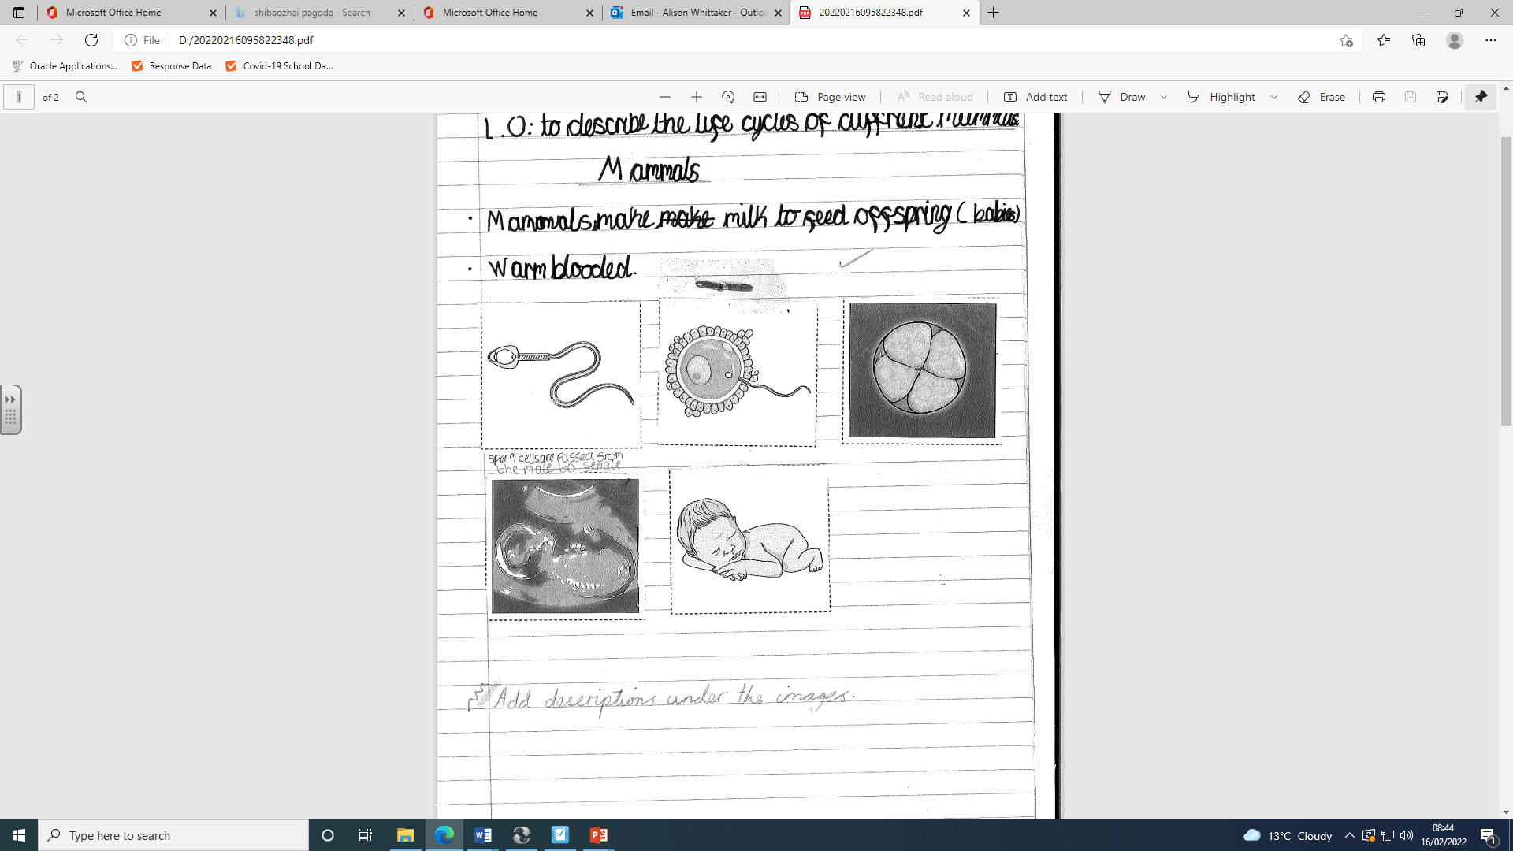

Slide 10
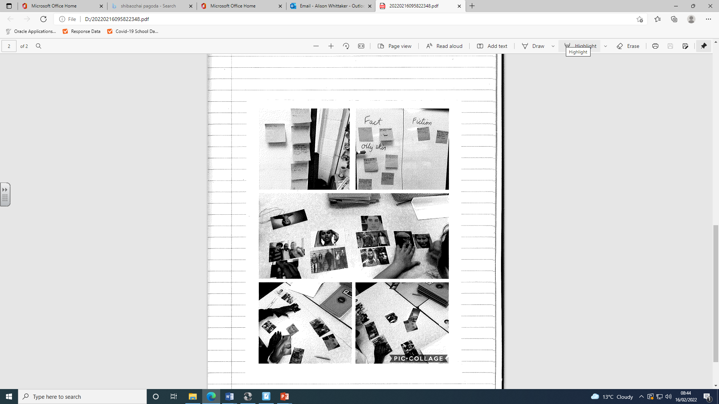

Slide 11
RSE expectations: primary
Here’s what all pupils should know by the end of primary school. These are the expectations set by the Department for Education. In Kingsley we teach this through our PHSE and wider curriculum.
Families and people who care for me
Caring friendships
Respectful relationships
Being safe

Slide 12
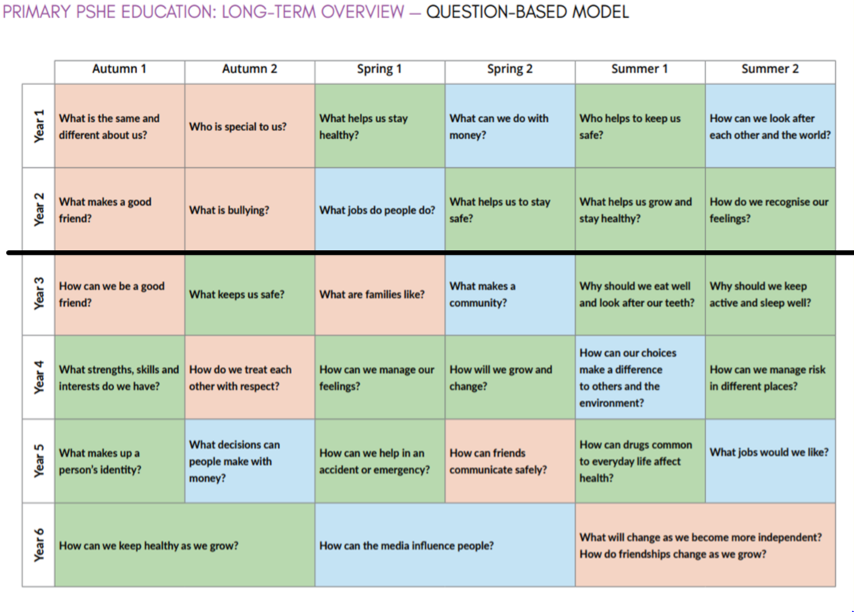

Slide 13

Topic: Relationships (Ourselves and others; similarities and differences; individuality; our bodies)
Question: What is the same and different about us?
PSHE AT KINGSLEY: Year 1
Learning Expectations:
In this Unit pupils will learn:
What they like/dislike and are good at
What makes them special and how everyone has different strengths
How their personal features or qualities are unique to them
How they are similar or different to others, and what they have in common
To use the correct names for the main parts of the body, including external genitalia; and that parts of bodies covered with underwear are private
Programme of Study References
H21, H22, H23, H25, R13, R23, L6, L14
Essential Knowledge:
I know different feelings change the way I feel.
When I make right choices this effects my physical and emotional health.
If I make any wrong choices, this can have a not so good consequence.
I know that I am unique and there is not another me.
I know my strengths and weakness and these may be different to others.
I know what makes me different and that everyone is not the same.
I can name the different parts of my body.
Key Websites:
PSHE Association – Inclusion, belonging and addressing extremism, (KS1), ‘Sameness and difference’
Medway Public Health Directorate - Primary RSE
Lessons (KS1), Lesson 3, ‘Everybody’s body’
NSPCC – The underwear rule resources (PANTS)
Cross Curricular:
Art
R.E
Key Vocabulary:
Feelings, physical, health, emotional health, unique, consequence, confidence, strength, weakness, vulva, penis , testicle, chest

Slide 14
PSHE AT KINGSLEY: Year 5
Topic: Living in the Wider World (Money; making decisions; spending and saving)
Question: What Decisions Can People Makes With Money?
Learning Expectations:
How people make decisions about spending and saving money and what influences them
How to keep track of money so people know how much they have to spend or save
How people make choices about ways of paying for things they want and need (e.g. from current accounts/savings; store card/ credit cards; loans)
How to recognise what makes something ‘value for money’ and what this means to them
That there are risks associated with money (it can be won, lost or stolen) and how money can affect people’s feelings and emotions
Programme of Study References:
R34, L17, L18, L20, L21, L22, L24
Essential Knowledge:
I know the different ways to save and manage money.
I need to budget my money in order to buy the things that I need and want.
I understand you need to keep track of your money.
I understand the different values for money and what it means to me.
I know there are risks and consequences when people borrow money/ take out a loan.
I understand that some retailers will try and influences how I spend my money.
Key Websites:
https://www.bankofengland.co.uk/education/education-resources/top-tips-on-economic-wellbeing
Cross Curricular:
Mathematics
Key Vocabulary:
Spending, saving, influencing, track, money, current accounts, savings, store card, credit cards, loans, risk, lost, stolen.

Slide 15
PSHE AT KINGSLEY: Year 6
Topic: Relationships (Different relationships, changing and growing, adulthood, independence, moving to secondary school)
Question: What will Change As We Become More Independent?
Learning Expectations:
That people who are attracted to and love each other can be of any gender, ethnicity or faith; the way couples care for one another
That people have different kinds of relationships in their lives, including romantic or intimate relationships
That adults can choose to be part of a committed relationship or not, including marriage or civil partnership
That marriage should be wanted equally by both people and that forcing someone to marry against their will is a crime
How puberty relates to growing from childhood to adulthood
How growing up and becoming more independent comes with increased opportunities and responsibilities
How friendships may change as they grow and how to manage this
How to manage change, including moving to secondary school; how to ask for support or where to seek further information and advice regarding growing up and changing
Programme of Study References:
H24, H30, H33, H34, H35, H36, R2, R3, R4, R5, R6, R16
Essential Knowledge:
I know that I will go through physical and emotional changes as I go through puberty.
I can challenge society’s perception of a perfect body.
I know where to go and who to talk to if I need help or advice.
I know that I have rights within a relationship.
Key Websites:
NSPCC – Making sense of relationships (KS2)
PSHE Association – Mental health and wellbeing (KS2 – Y5/6), lesson 3, Feelings and common anxieties when transitioning to secondary school
Rise Above – Transition to secondary school
Cross Curricular:
Science
Key Vocabulary:
Respect, sex, gender, sexuality, prejudice, peer pressure, secrets, confidential, healthy, unhealthy, relationships, puberty, emotions, body image, gay, bisexual, lesbian, growing up, heterosexual, homosexual, menstruation, periods, hormone, changes, genitals.

Slide 16
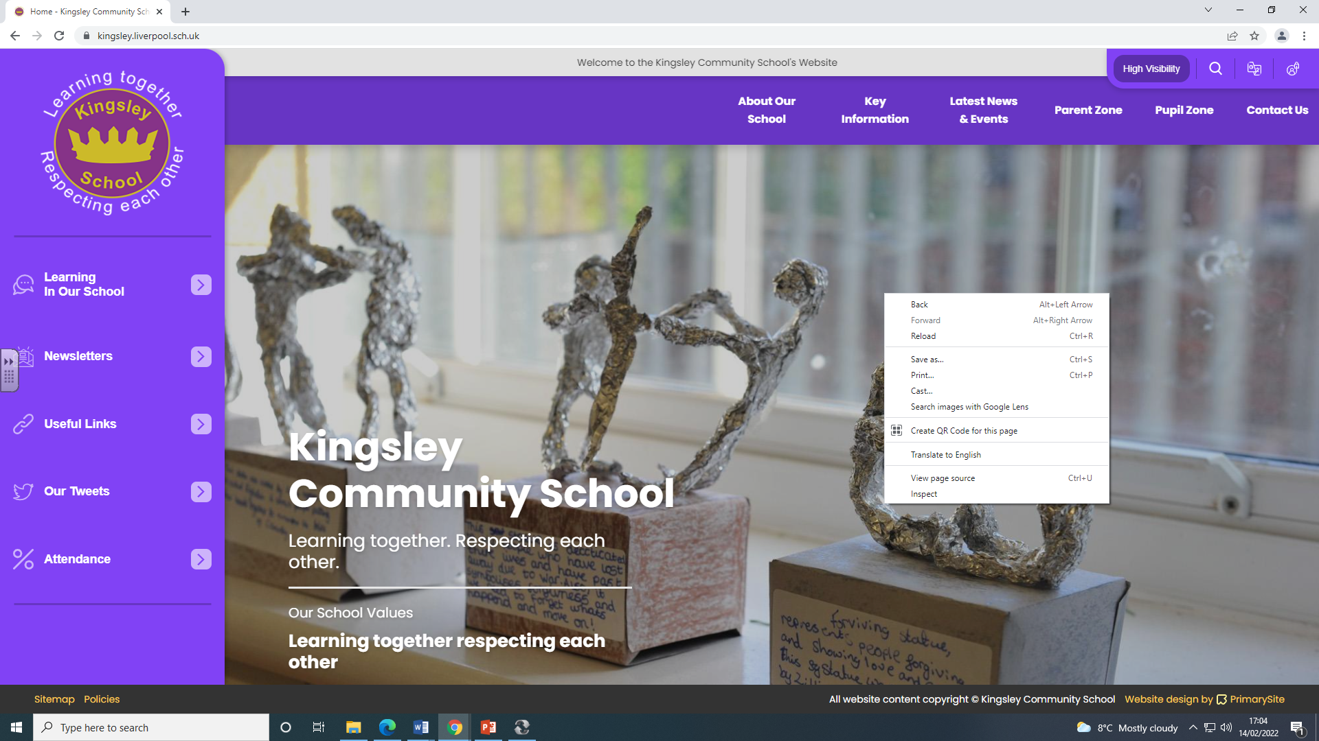
www.kingsley.liverpool.sch.uk

Slide 17
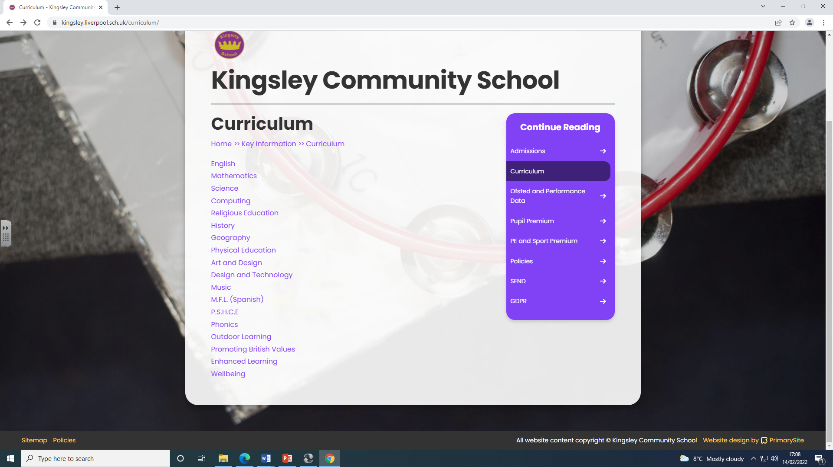
Curriculum content

Slide 18
PHSE Is A lesson like No Other
Discussion focussed
Not formally recorded at length
Open ended

Slide 19
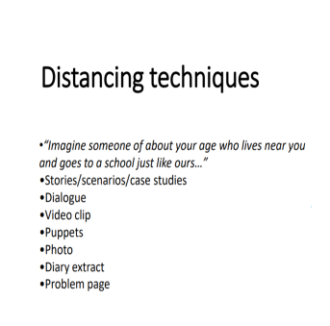
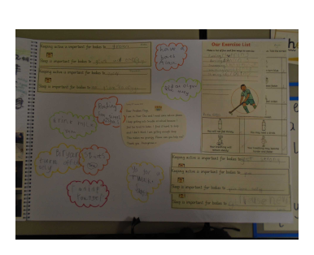
How Its Taught
Dear Problem Page,
My mum always says I have to give her friends a kiss when
they are leaving because it is polite. Her friends are nice
but I feel embarrassed and I don't want to kiss them.
I am not a baby. What should I do?
Girl aged 8.

Slide 20
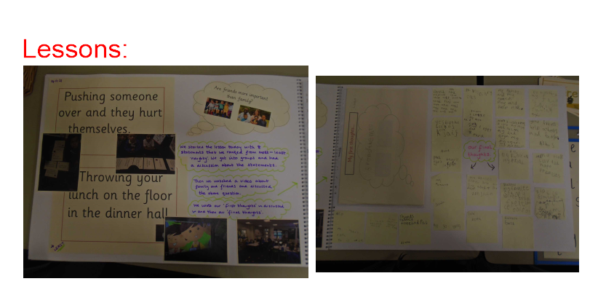
Lessons

Slide 21
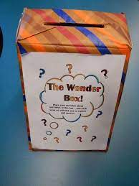
Question Box

Slide 22
Frequently Asked Questions/ Themes ….
School is trying to balance
- needs of the pupils
- statutory requirements
- parental concerns
That’s a BIG ASK.
We have used our professional judgement to create a curriculum that suits our school
Ask the school- don’t google or listen to facebook!

Slide 23
Concerns
Our school is proud to be a Community School in its true sense. During their time here your child will not only have access to good teaching and learning but will also work alongside staff and pupils who demonstrate a strong community ethos. This means that every child will be expected to show good manners, kindness and a respect for those from different faiths and family backgrounds. As we are a community school, we follow all aspects of the National Curriculum, which we expect all of our children to take part in.
Addressed to the Head teacher- in writing.
Refer to Dfee handout.

Slide 24
Research
Last large scale survey 2018- suggests that:
- Young people who have RSE in school are less likely to take sexual risks.
- Vast majority of pupils said they found it useful
- There is a strong suggestion that there is a link between good PHSE and pupil well being.

Slide 25
At Its Core
Keep pupils safe
Prepare pupils for adolescence
Help them to understand and respect relationships in our community and in wider society
Prepare them for the world of work / professional life.
Regardless of anyone’s beliefs about right and wrong, PHSE should reinforce our shared common values
1. Respect for each other
2. Kindness in the way we treat others
3. Living peacefully together.

