Slide 1

Kingsley Primary
School
Early Years Transition Meeting
June 2025

Slide 2
Staff
Head Teacher – Mrs Alison Whittaker
Deputy Head – Miss Alison Edwards
Early Years Lead/Asst Head - Adele Gold
Attendance – Jen Bedford
Reception Classes – Miss Williams, Miss Paterson
Teaching Asst: Miss Stephenson, Mrs Burke, Miss Wilcocks.
SEN Support: Mrs Lefta
School Readiness: Sarah Yafai

Slide 3
Times of the Day
Reception
First week (Tuesday 2nd to Thursday 4th):
9:00-11:00am or 1:00pm -3:00pm
Friday 5th will be a full day for all children 9am -3pm
From the second week: School starts at 8.40am prompt
11:30 -12.30pm lunch
3.15pm school finishes
All children have continuous play (indoors and outdoors) throughout the day.
Must have a ‘password’ if being collected by someone else.

Slide 4

Uniform
Purple jumper or cardigan with logo. (office)
Grey/black pants or skirt.
White Polo shirt
White or grey socks
Plain purple/black hijab
Black VELCRO shoes
PE kits needed from January.
Dark shorts/leggings
White t-shirt Black pumps
________________
Wellington Boots
Please ensure all uniform is labelled.

Slide 5
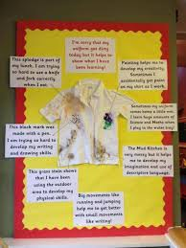
I’m sorry that my uniform got dirty today but…

Slide 6
School Lunches
School Dinners
Choices of hot or cold
Variety of choices including vegetarian.
Nut free
Packed Lunches
Water, no fizzy drinks or energy drinks.
Balanced nutritious diet
Nut free
Packed lunches are monitored.

Slide 7
Attendance
Very important. This year there was a definite correlation between attendance and attainment.
All attendance and punctuality are recorded. If abroad for 5+ days will be fined by LEA.
Education Welfare Officer involvement.
Mrs Bedford is our attendance officer
Please call the school to report absence.

Slide 8
Snack
All children have the opportunity for continuous snack. They will have milk and a healthy snack.
A cookery/baking lesson when possible

Slide 9
Medication
If your child is on medication, let us know.
If your child requires medication in school, call in to the front office. You will need to complete a form.

Slide 10

School Ready…
https://startingreception.co.uk/

Slide 11
Learning Opportunities
Play based curriculum ~ learning through play using a ‘hands on’ approach (levels of play).
Literacy and Numeracy taught every day and then reinforced through play.
Planning will reflect the childrens’ interests.
Teaching will take place indoors and outdoors: all 7 areas of learning.

Slide 12
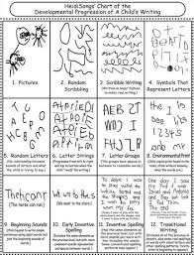
Stages of Writing

Slide 13
Outdoor Provision
Whatever is done in the classroom ~ is done outside…regardless of weather! Aprons are provided.
Your children will have lessons outside in all weathers! Wet weather clothes available.
Please provide your child with wellington boots to be left in school. Labelled with full name!

Slide 14
Early Years Foundation Stage
Curriculum for children 0-5 years old
Divided into 7 areas of learning.
All children are assessed against the revised EYFS.
Stay & Play to look at work and speak with the teacher.
Parent mornings.

Slide 15
Phonics
How we teach your child how to read and write.
20 minutes every day leading up to twice a day…
The children may work with different teachers.
Class reading book (when appropriate). Please read with your child every night.
There will be a phonics session after September. Please attend!

Slide 16
Support from home
Your child goes to bed at a reasonable hour with a routine including being read to.
Let us know if you have any worries.
Your child is on time every day.
Your child attends school every day. If your child is ill, please call the school to let us know.

Slide 17
Stay and Play
When children are settled…
Various days (letter goes home)
Activities based around work covered that week.
Check website and Text messages

Slide 18
Parents
School trips and outings
Confidentiality ~ speak to the teachers.
Need up to date contact information.
Collection of child (inform teacher)
Mrs Yafai’s courses: independence, behavior, self regulation, nurture, sleep

Slide 19
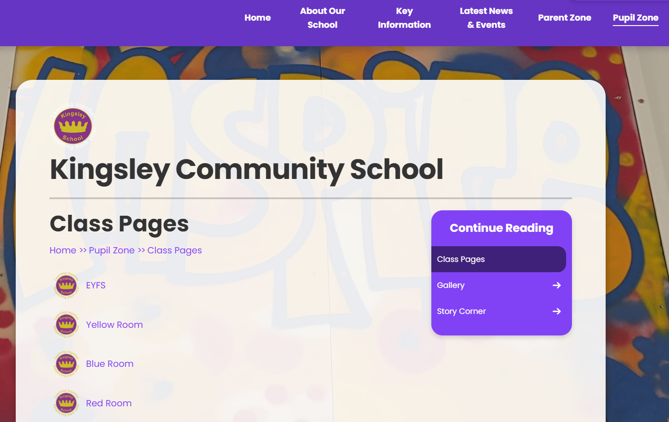
Website
https://www.kingsley.liverpool.sch.uk

Slide 20
Questions
Please feel free to ask us any questions that you may have
We hope you and your child really enjoy your visit today!

